Slide 1
Views in SQL

Slide 2
Views in SQL are kind of virtual tables. A view also has rows and columns as they are in a real table in the database.
We can create a view by selecting fields from one or more tables present in the database.
A View can either have all the rows of a table or specific rows based on certain condition.
In this article we will learn about creating , deleting and updating Views.

Slide 3
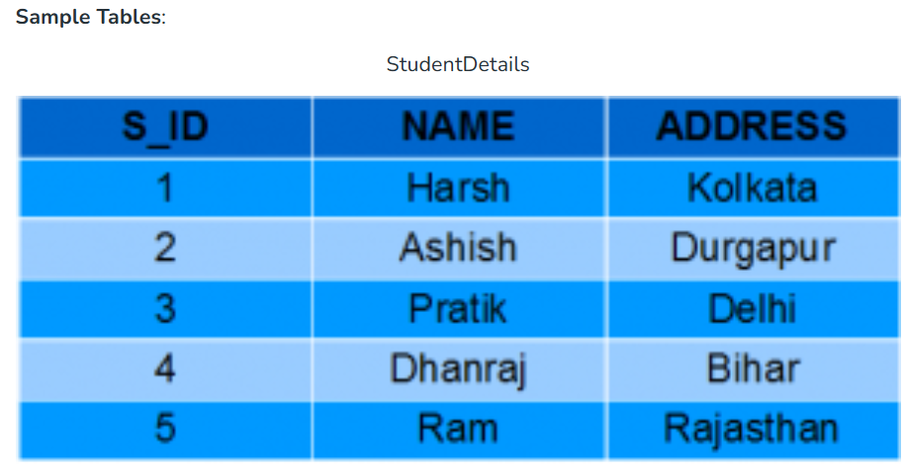

Slide 4
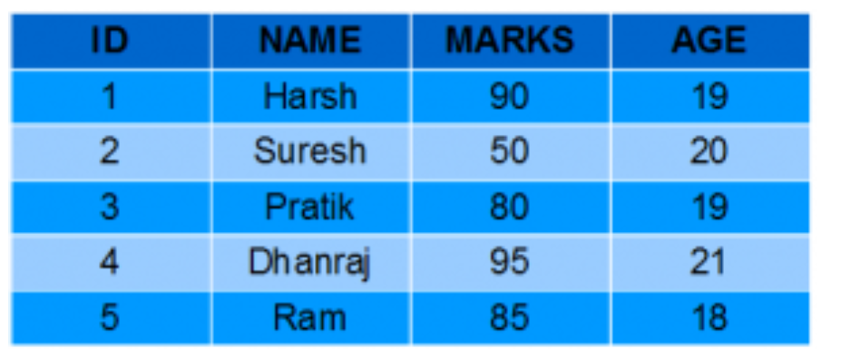

Slide 5
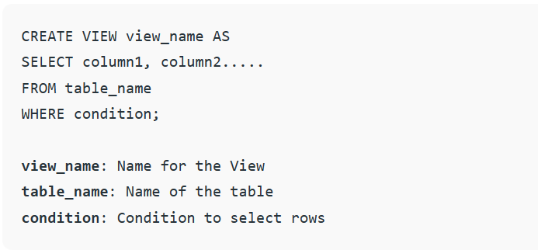
Creating View
We can create View using CREATE VIEW statement. A View can be created from a single table or multiple tables. Syntax:

Slide 6
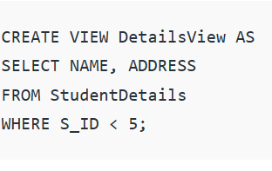
Examples:
Creating View from a single table:
In this example we will create a View named DetailsView from the table StudentDetails. Query:
To see the data in the View, we can query the view in the same manner as we query a table.
SELECT * FROM DetailsView;

Slide 7
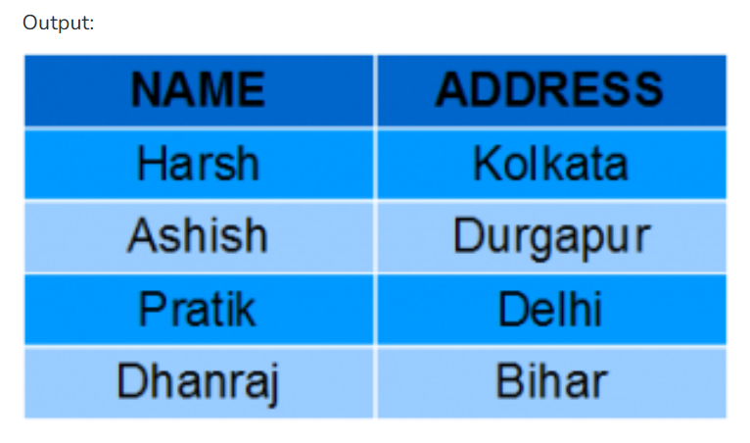

Slide 8
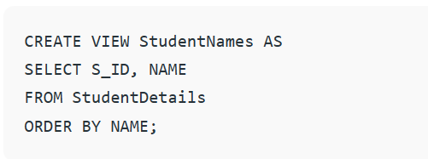
In this example, we will create a view named StudentNames from the table StudentDetails. Query:
If we now query the view as,
SELECT * from StudentNames;

Slide 9
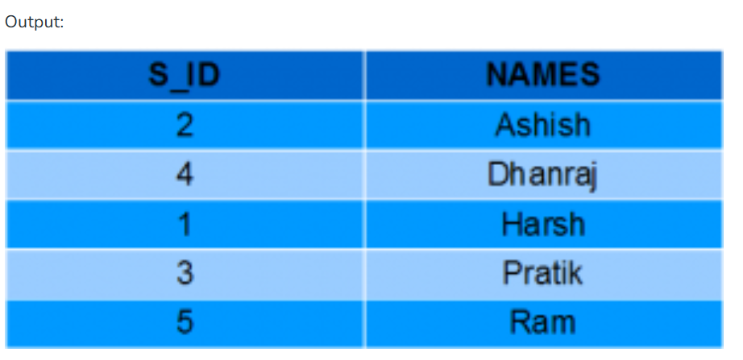

Slide 10
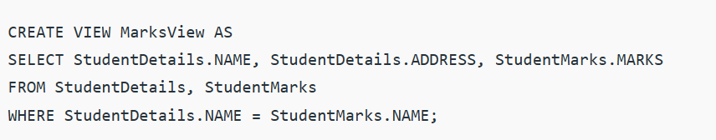
Creating View from multiple tables:
In this example we will create a View named MarksView from two tables StudentDetails and StudentMarks.
To create a View from multiple tables we can simply include multiple tables in the SELECT statement.
Query:

Slide 11
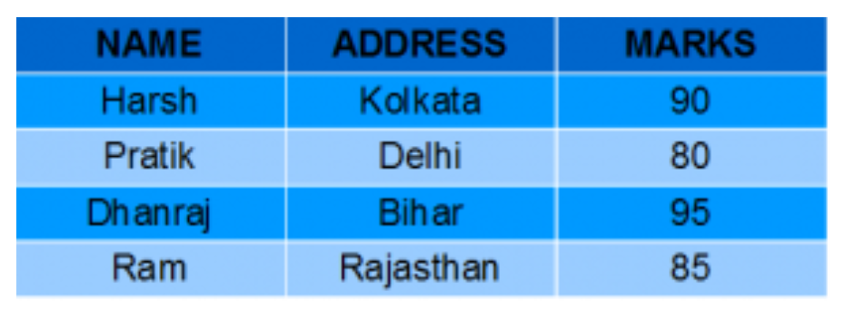
To display data of View MarksView:
SELECT * FROM MarksView;
OUTPUT:

Slide 12
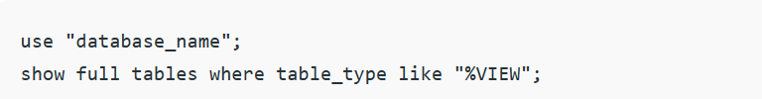
LISTING ALL VIEWS IN A DATABASE
We can list View using the SHOW FULL TABLES statement or using the information_schema table. A View can be created from a single table or multiple tables.
Syntax (Using SHOW FULL TABLES):

Slide 13
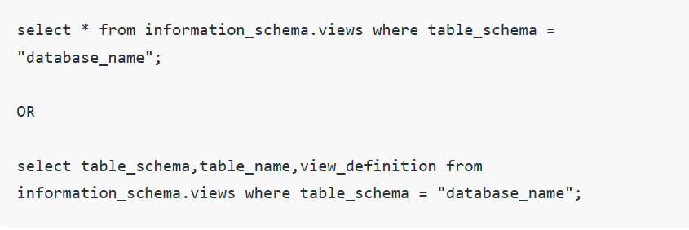
Syntax (Using information_schema) :

Slide 14
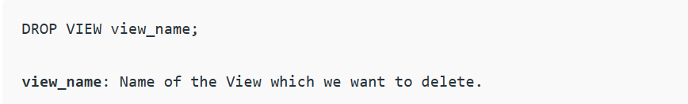
DELETING VIEWS
We have learned about creating a View, but what if a created View is not needed any more? Obviously we will want to delete it.
SQL allows us to delete an existing View. We can delete or drop a View using the DROP statement.
Syntax:

Slide 15
For example, if we want to delete the View MarksView, we can do this as:
DROP VIEW MarksView;

